Slide 1
SISTEMAS OPERATIVOS
SO
E – M 2019

Slide 2
Op Sys, Organizational Structures
Op Sys, Organizational Structures
Architectures (cont.)

Slide 3
Computers Systems – Cross Platform
Allows Native Operating Systems to run applications within other Guest Operating Systems
Vast and growing industry
Emulation used when source CPU type different from target type
Generally slowest method
When computer language not compiled to native code – Interpretation
Virtualization – OS natively compiled for CPU, running guest OSes
Consider VMware running Win7 guests, each running applications, all on native Win10 host OS
VMM (Virtual Machine Manager) provides virtualization services

Slide 4
Virtualization in Computers Systems

Slide 5
Virtual Machines
A virtual machine provides an interface similar to the underlying bare hardware.
It treats hardware and the operating system kernel as though they were all hardware.
The Operating System creates the illusion of multiple processes, each executing on its own processor with its own (virtual) memory.
A virtual machine takes the layered an the microkernel approach to its logical conclusion.
Each guest provided with a (virtual) copy of underlying computer.

Slide 6
Virtual Machines (Cont.)
The resources of the physical computer are shared to create the virtual machines.
CPU scheduling can create the appearance that users have their own processor.
Spooling and a file system can provide virtual card readers, line printers, keyboards, monitors, memory, storage, ...
A normal user time-sharing terminal serves as the virtual machine operator’s console.

Slide 7
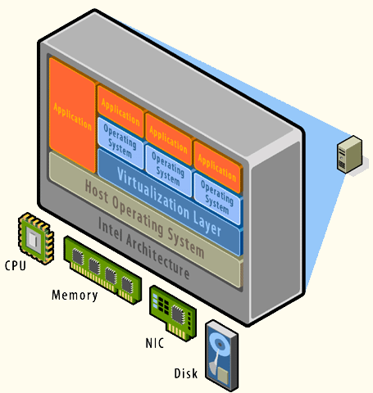
VMs Environment 1
An Operating System Host supporting several Operating System Guests
Products: VMware; VirtualBox; MS Virtual PC

Slide 8
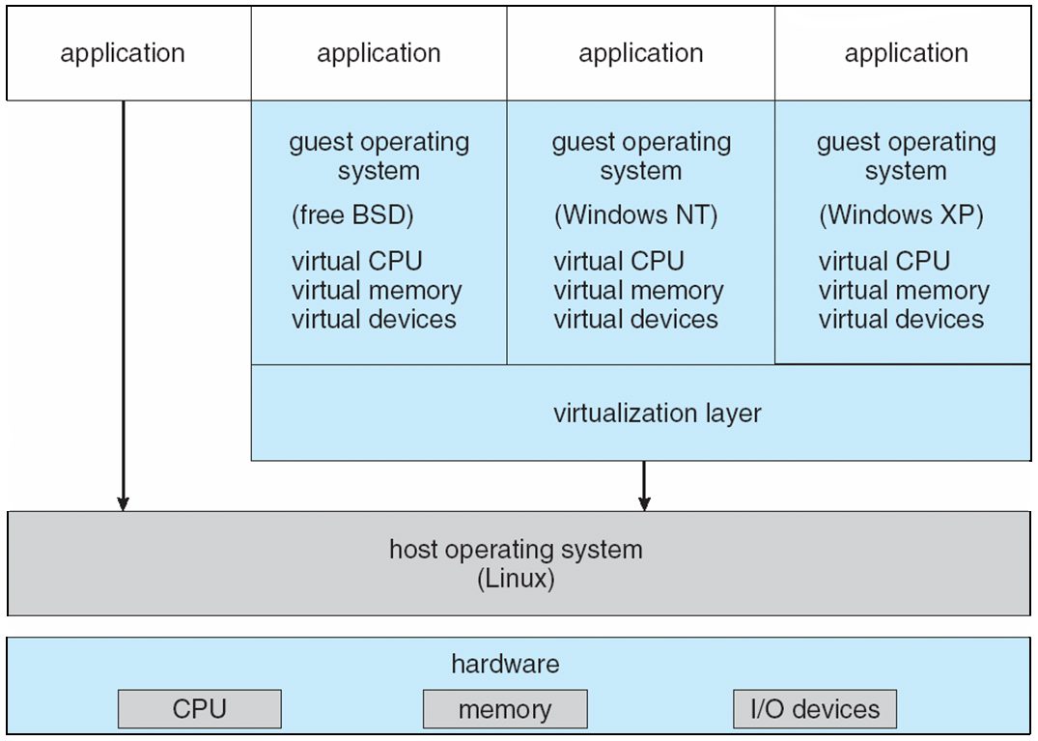
VMware Architecture

Slide 9
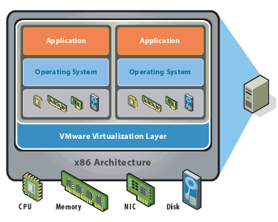
VMs Environment 2
A Virtualization Layer supporting several Operating System Guests
Products: VMware ESX; MS Hyper-V

Slide 10
Advantages/Disadvantages of Virtual Machines
The virtual-machine concept provides complete protection of system resources since each virtual machine is isolated from all other virtual machines. This isolation, however, permits no direct sharing of resources.
A virtual-machine system is a perfect vehicle for operating-systems research and development. System development is done on the virtual machine, instead of on a physical machine and so does not disrupt normal system operation.
The virtual machine concept is difficult to implement due to the effort required to provide an exact duplicate to the underlying machine.

Slide 11
Cloud Computing
Delivers computing, storage, even apps as a service across a network
Logical extension of virtualization because it uses virtualization as the base for it functionality.
Amazon has thousands of servers, millions of virtual machines, petabytes of storage available across the Internet, pay based on usage
Many types
Public cloud – available via Internet to anyone willing to pay
Private cloud – run by a company for the company’s own use
Hybrid cloud – includes both public and private cloud components
Software as a Service (SaaS) – one or more applications available via the Internet (i.e., word processor)
Platform as a Service (PaaS) – software stack ready for application use via the Internet (i.e., a database server)
Infrastructure as a Service (IaaS) – servers or storage available over Internet (i.e., storage available for backup use)

Slide 12
Cloud Computing
Cloud computing environments composed of traditional OSes, plus VMMs, plus cloud management tools
Internet connectivity requires security like firewalls
Load balancers spread traffic across multiple applications

Slide 13
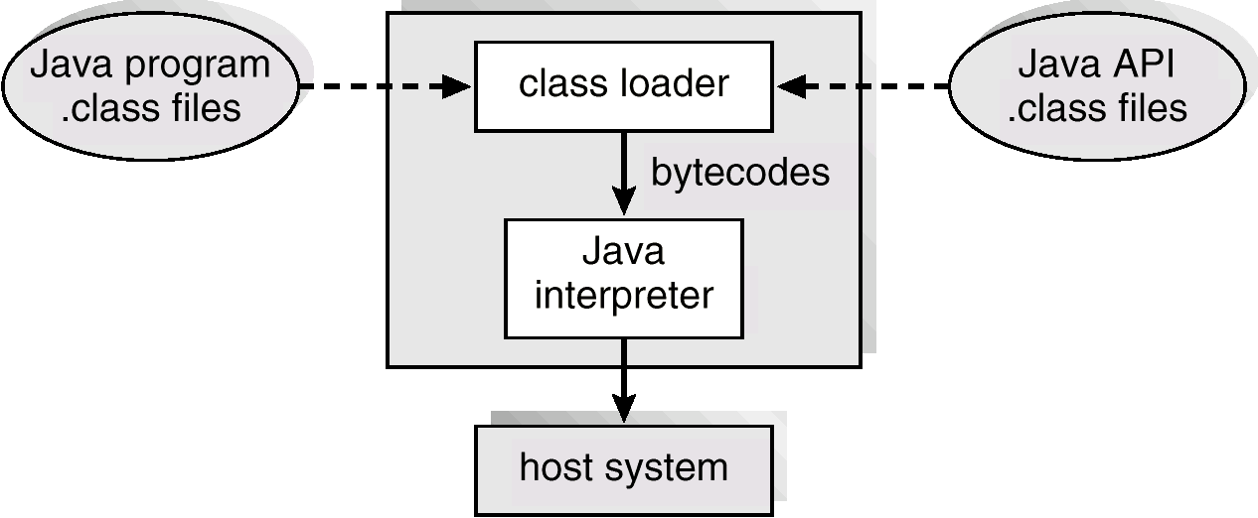
The Java Virtual Machine - JVM
Virtual Machines supporting processing.
Virtual OS with no support for users and no storage.

Slide 14
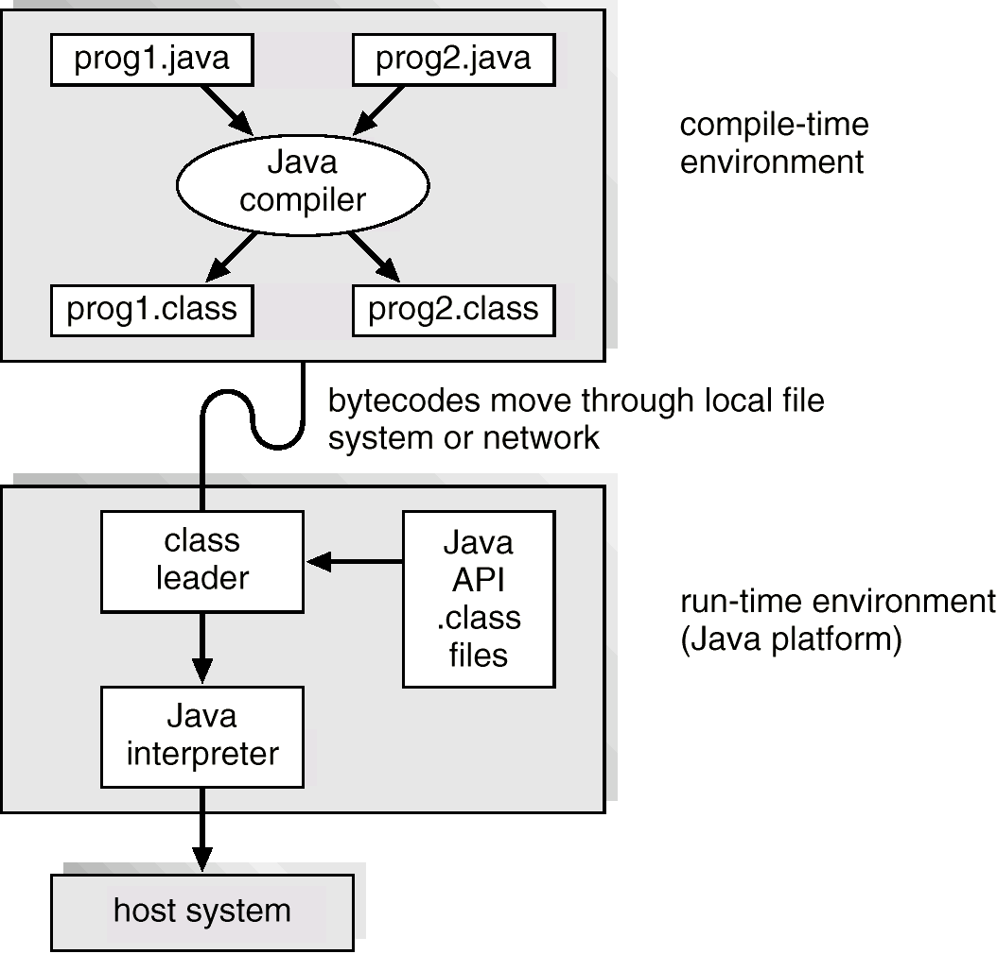
Java Development Environment

Slide 15
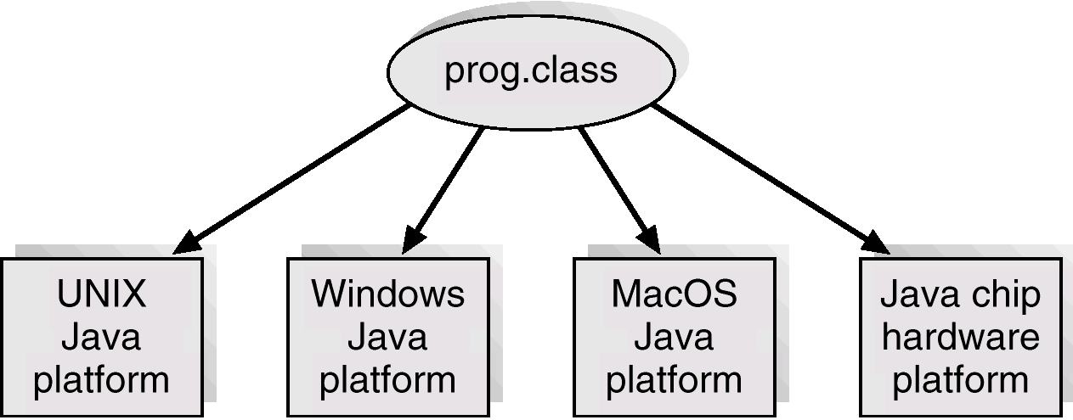
Java .class File on Cross Platforms

Slide 16
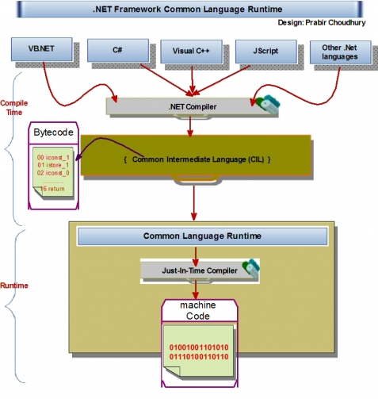
CLR for .NET Framework

Slide 17
References
Presentación de Ramon Ríos.
Capítulos: Operating System Concepts; Silberschatz, Galvin, Gagne.
05-feb-2019

